Slide 1
Name: Akhil Ravindra Gangan Roll no: 530 Topic: Business Intelligence

Slide 2
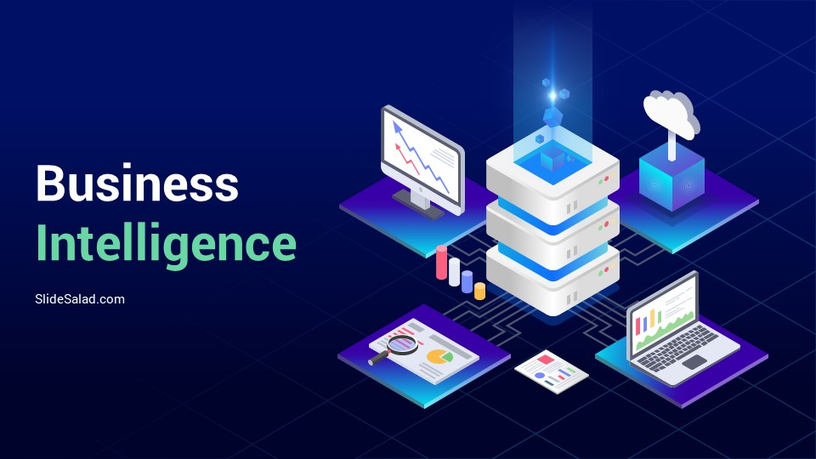
Business
Intelligence

Slide 3
What is Business Intelligence
Business Intelligence process
Types of BI
Pros & Cons

Slide 4

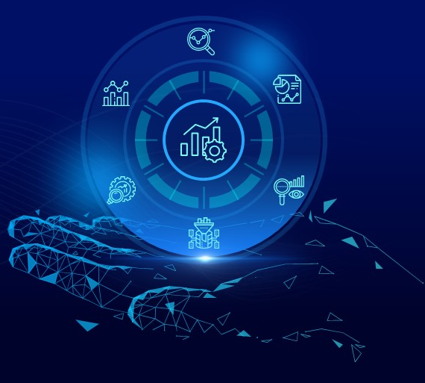
What is Business Intelligence
Business Intelligence is the processes, technologies, and tools that help us change data into information, information into knowledge and knowledge into plans that guide organization.
Technologies for gathering, storing, analyzing and providing access to data to help enterprise users make better business decisions.

Slide 5
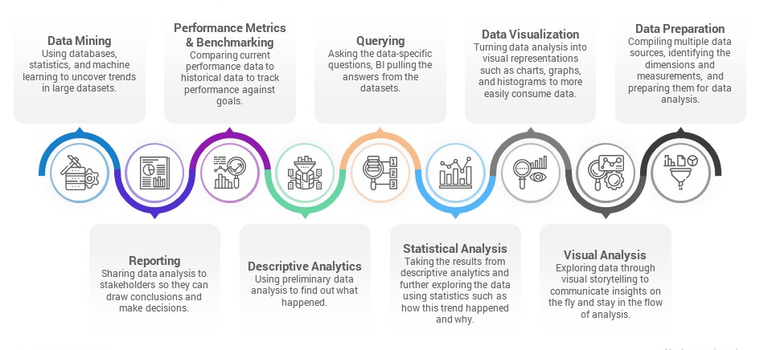
Business Intelligence process:

Slide 6
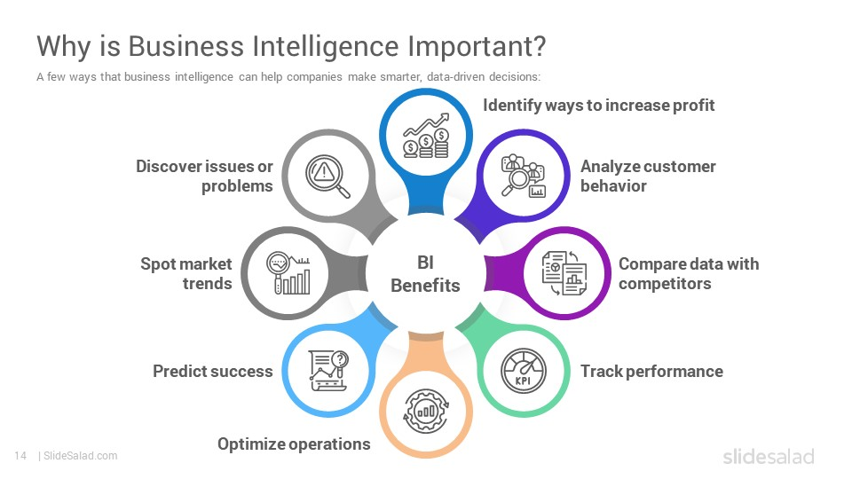
Why is Business Intelligence Important ? :

Slide 7
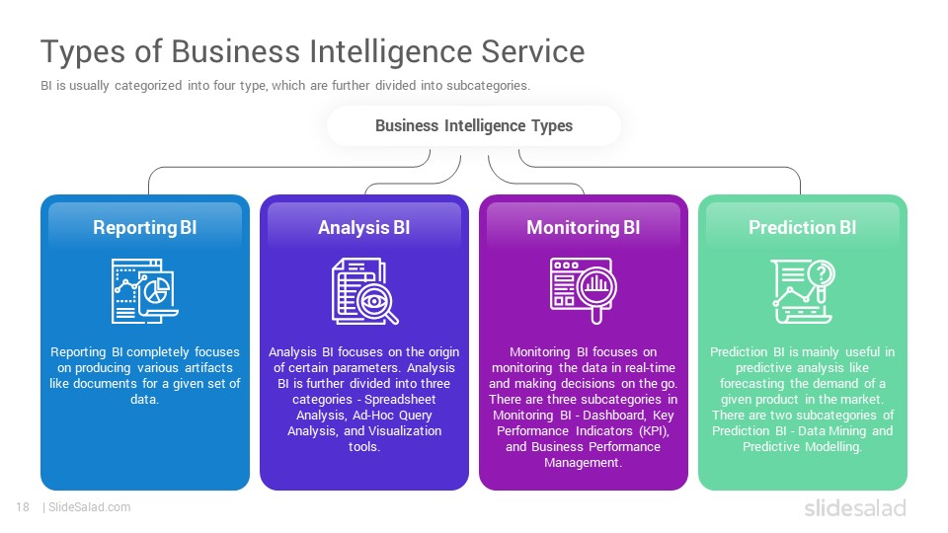
Types of Business Intelligence:

Slide 8
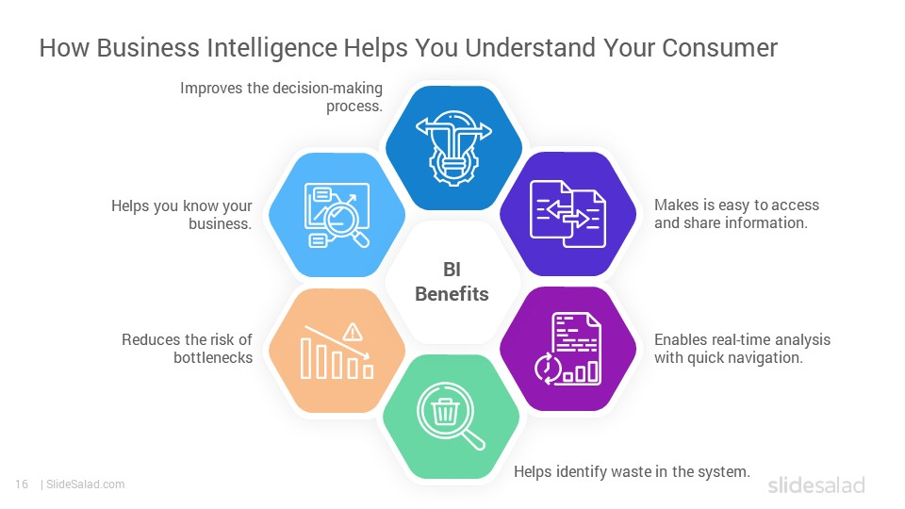
Advantages of Business Intelligence:

Slide 9
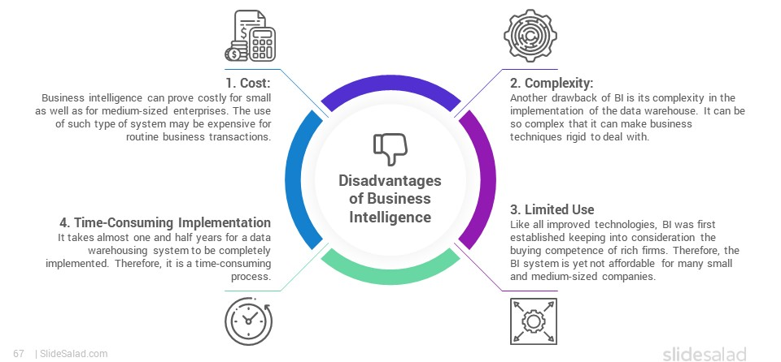
Disadvantages of Business Intelligence:

Slide 10
Thank You……!!!

